Slide 1
Crazy Button Workshop

Slide 2
Breakdown
Part 1: Introduction
Client-Server Architecture
WebSocket
Overall model
Frontend codes
Backend codes
Part 2: Live Coding
Frontend (HTML, JS and CSS)
Backend (Python)

Slide 3

Hello!
I am Bryan
Year 4 Business and Computer Science

Slide 4
1.
Introduction
Let’s start get started!!
Notes:
Lets get started!!

Slide 5
What we will be building
A platform with:
Button
It moves to a random location when it is pressed
Leaderboard
Notes:
We will be building a platform with
-a button
-which moves to random location when its pressed
-a leaderboard

Slide 6
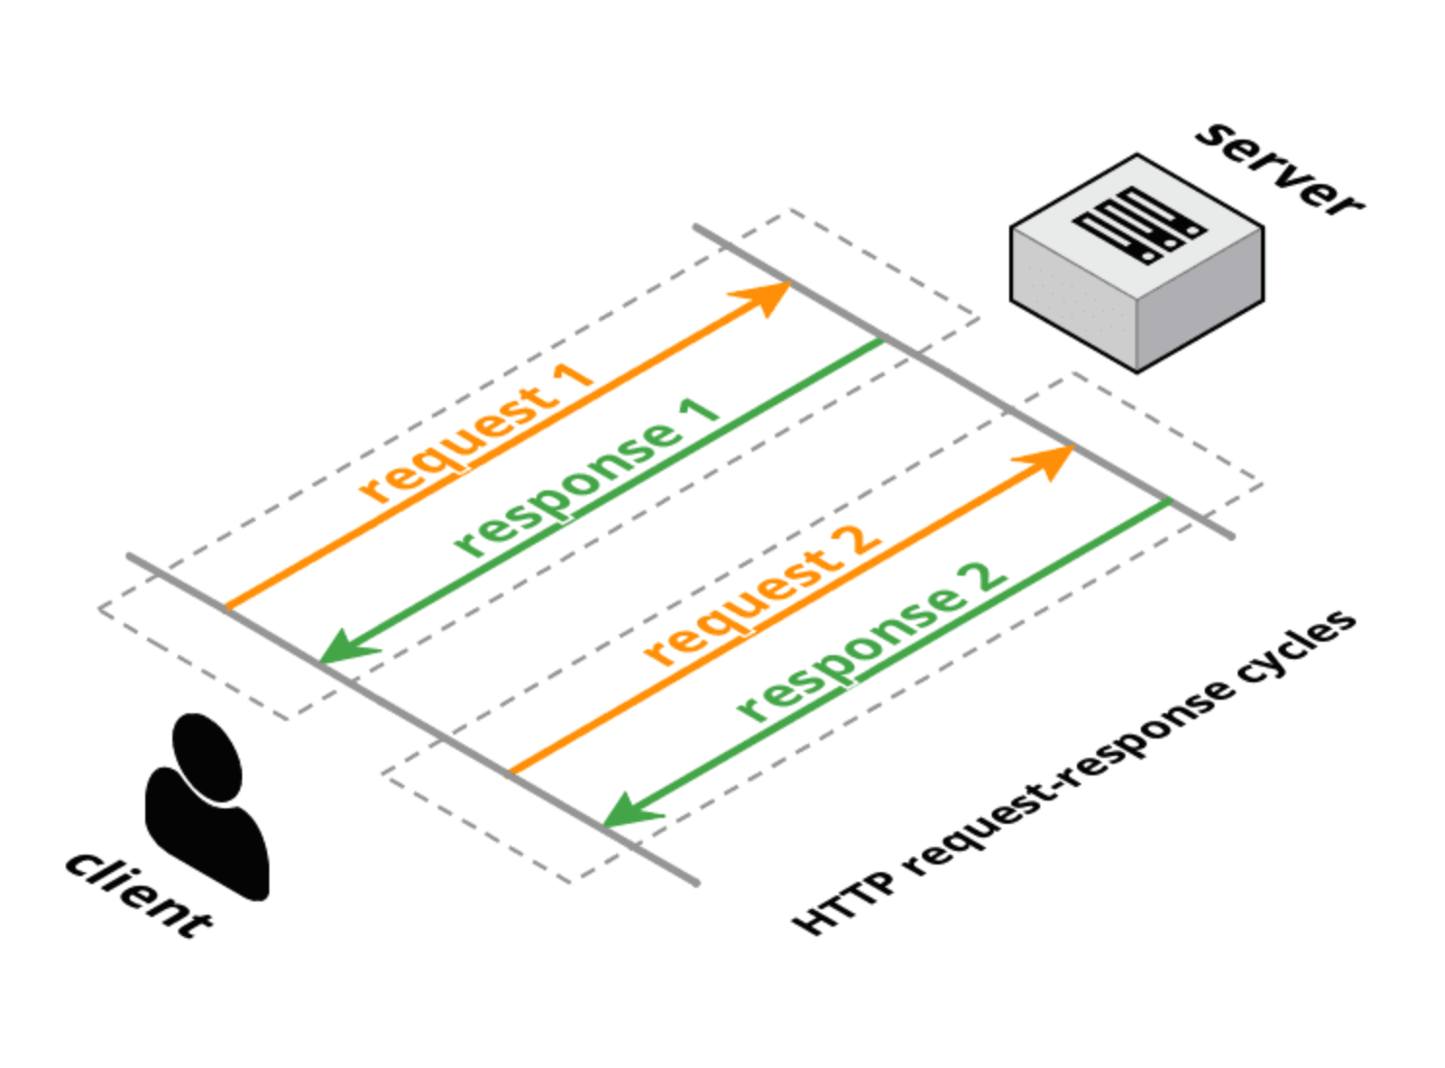
What is Client-Server Architecture?
Client request
Server respond with data
Repeat
Notes:
First let’s introduce the client-server architecture
It is like a communication between the client and the server.
First the Client will request for something
Then the server will respond with the data

Slide 7


Eg. Youtube
I want to watch “XYZ”
“XYZ video”
Client
Server

Slide 8
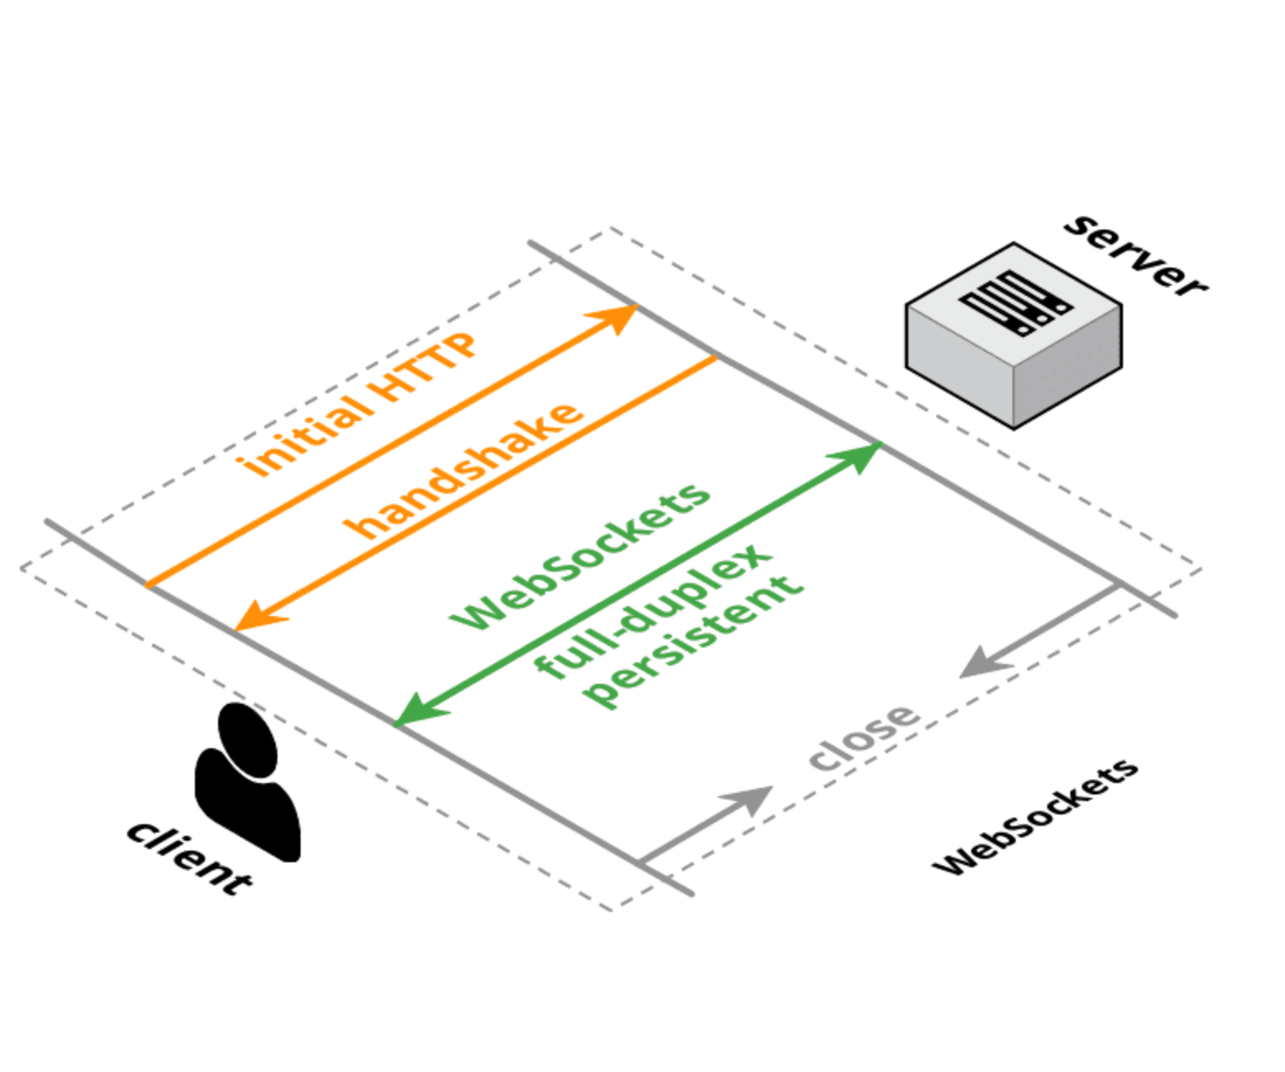
What is WebSocket?
Client request for handshake
Server respond with “OK”
Handshake established
Data can be transmitted through the handshake
Notes:
Websocket is built ontop of client-server architecture

Slide 9

Eg. Facebook
“Handshake?”
Connection
“OK”
Client
Server
Notes:
Facebook does not really use websocket.
We change example?

Slide 10
Why WebSocket?
Real time communication
Full duplex
Once button pressed, position will be updated on all players’ screen

Slide 11
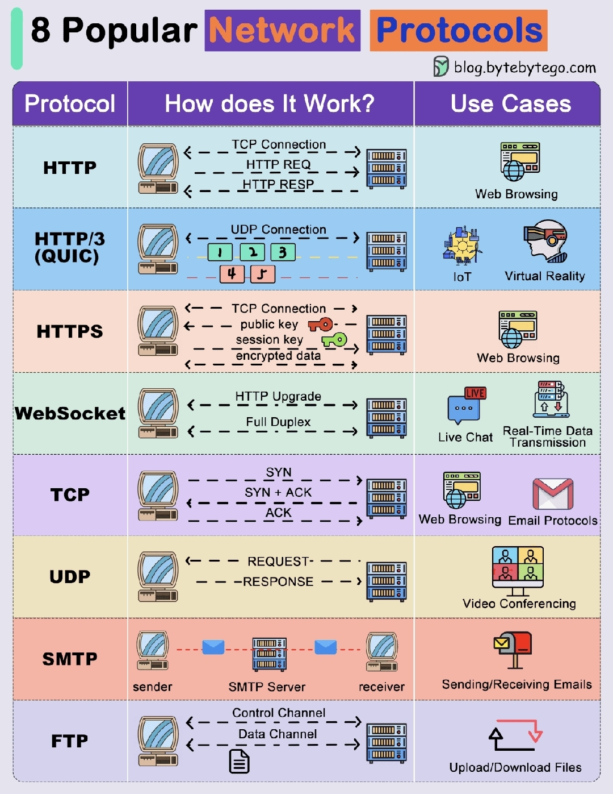
What are the alternative protocols?

Slide 12
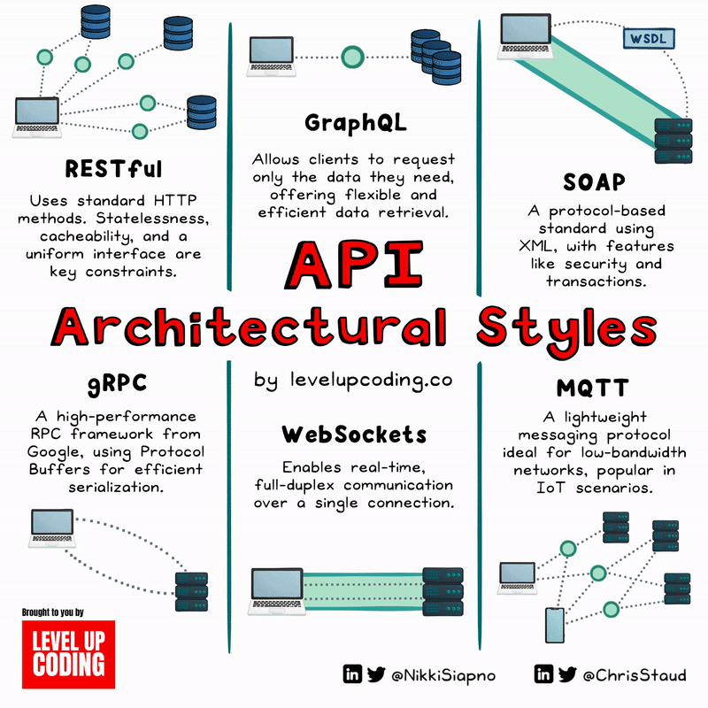
API Architectural Styles

Slide 13
2.
Our overall model

Slide 14
Our overall model
Laptop request server for handshake
Server respond with handshake confirmation
Server push data to client when:
New player enters
Button is clicked
A player left
Laptop process data from server

Slide 15


Initial connection
“player_connected”
Handshake?
Connection
OK

Slide 16
New player connected
“player_connected”
Connection
Handshake?
Connection
OK

Slide 17
The button was pressed
“button_pressed”
“new_button_location”
Connection
Connection
“button_pressed”

Slide 18
A player disconnects
“player_disconnected”
Connection
Connection
Notes:
Player disconnects

Slide 19
3.
Codes
Notes:
We will discuss core concepts but not the syntax of the codes

Slide 20
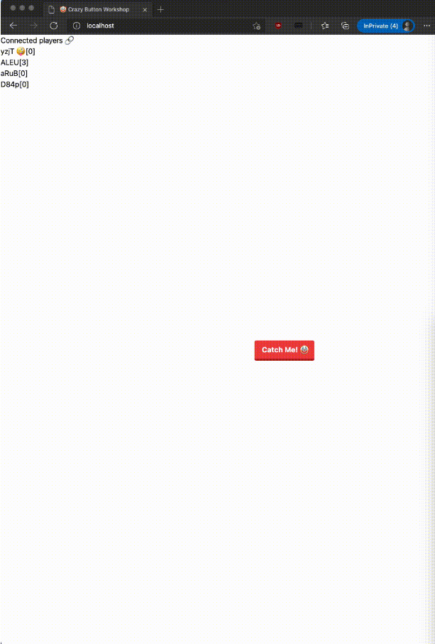
Frontend
Backend
Notes:
Frontend is what the user interact with
Backend is a server to does processing work

Slide 21
3.1
Frontend codes
Notes:
We will discuss core concepts but not the syntax of the codes

Slide 22
What we want on Frontend
A button for players to click
Button move to random location on every player’s screen when it is clicked
Leaderboard to show a list of connected players
You at the top of the list
Show score of every player
Notes:
What we want to create in frontend

Slide 23
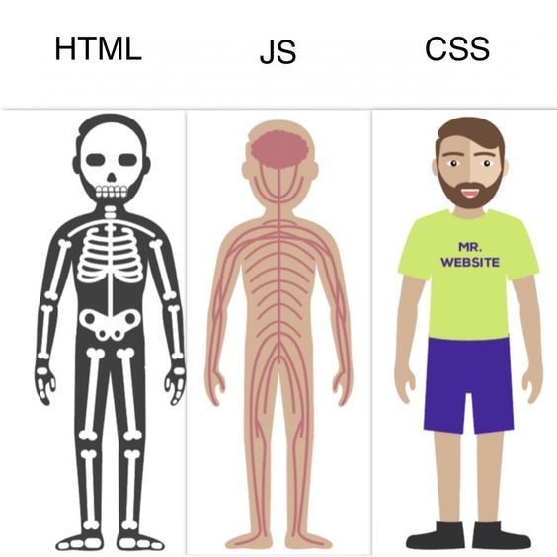
HTML, JS and CSS

Slide 24
HTML tags
<html>...</html>
Put everything inside except <!DOCTYPE html>
<head>...</head>
Title
<body>...</body>
Main content
<script>...</script>
Javascript functions
Notes:
<html> tag is a standard convention
<!DOCTYPE html> is not a html tag. It tells the browser what document type to expect. For this case, its html

Slide 25
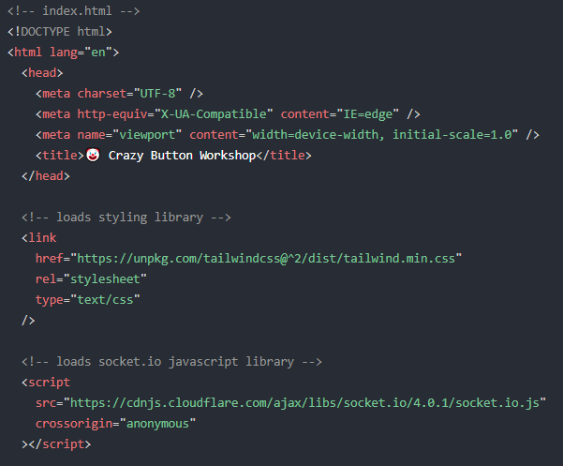
index.html
Notes:
Moving on the the code itself, the file should be named index.html
It should contain
Header tag
Boilerplate code with title of the webpage
written text that can be reused in new contexts or applications without significant changes to the original.
We will be importing
Tailwind CSS
Styling library. Will be used for the button
Socket.IO
socket script that we will be using
Now lets move on to the helper functions

Slide 26
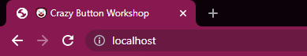
index.html

Slide 27
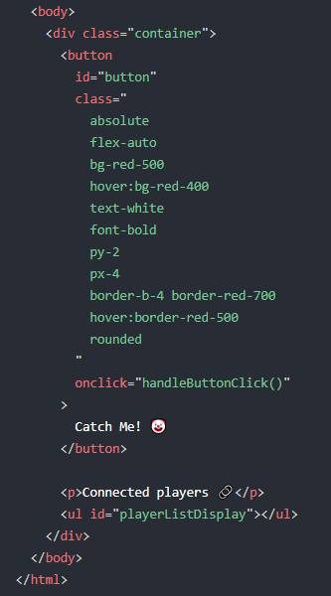
Body of index.html
Notes:
The body only contains a button and the leaderboard list

Slide 28
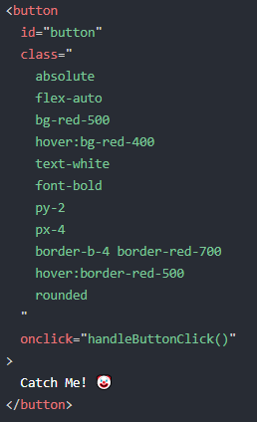
Button
Notes:
We will start with the button
We give it an id=”button” to identify it, we will be referencing this button in other parts of the code.
That’s why we need to give it an identification
We style of the button
color , size, etc using tailwind CSS
Here we specify that when the button is clicked, we activate handleButtonClick() helper function
Lastly this is what to be displayed in the button

Slide 29
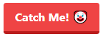
Button
Notes:
Here is what the button looks like with the text and styling

Slide 30
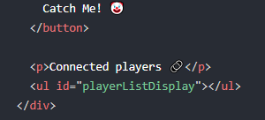
Leaderboard
Notes:
Next part of the body is the leaderboard
First we create a label “Connected players”
Then we create an unordered list with id=”playerListDisplay

Slide 31
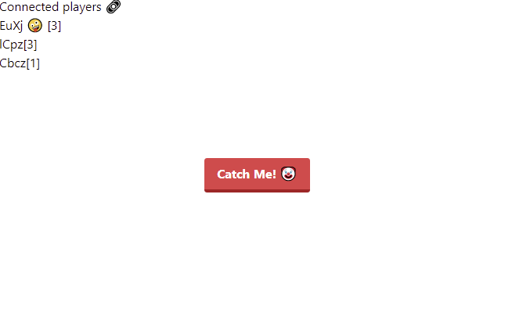
Frontend

Slide 32
index.html
Notes:
We will be importing
Tailwind CSS
Styling library. Will be used for the button
Socket.IO
socket script that we will be using
Now lets move on to the helper functions

Slide 33
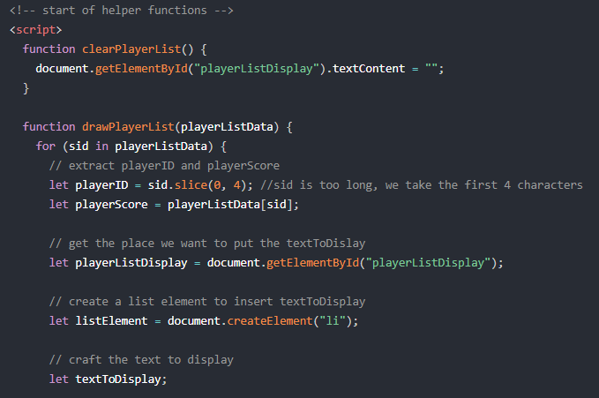
Helper functions
Notes:
The helper functions which are the logic that of the webpage. Written in js
Meaning, it contains instructions of what to do when certain actions occur
Let’s look through them one by one

Slide 34
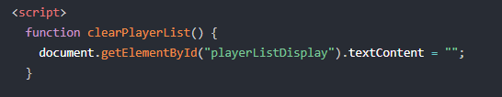
Function clearPlayerList
Notes:
clearPlayerList function
Deletes the leaderboard list

Slide 35
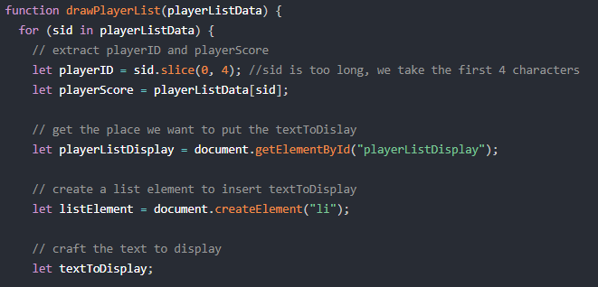
Function drawPlayerList
Notes:
drawPlayerList function
This function takes in playerListData
It will go through all the players in the list one by one
And for each player, We want to do execute these codes=>
Now lets look at what is playerListData and sid

Slide 36
playerListData
sid
score
{
“SdxtrkjLGVUlkjhnuiYTFTR”: 0
“6ppaCTQL4rjH1r7jAAAD0”: 1
“1iiPOUOJQKVh6ol9AAABs”: 2
}
Notes:
This is what playerListData looks like
Its a list that contains
A list of sid(player) along with their respective score
What this code means is
We are going through the list one by one

Slide 37
Function drawPlayerList
Notes:
We set playerID as the first 4 characters on sid
Since sid is too long

Slide 38
Function drawPlayerList
Eg. sid = “SdxtrkjLGVUlkjhnuiYTFTR”
playerID = “Sdxt”
Notes:
Here is an eg of sid
We take the first 4 characters and playerID

Slide 39
Function drawPlayerList
Notes:
Moving on, we
Get player score from the list using the id
Get the location on the webpage where we want to display the Leaderboard
Create a list element to put some text
Create the variable textToDisplay

Slide 40
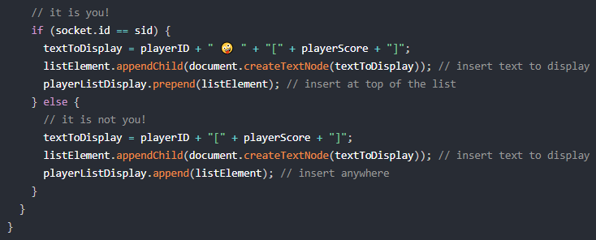
Function drawPlayerList
Notes:
Next, the function will check if the player in the list is you or not
First we look at when the player is you

Slide 41
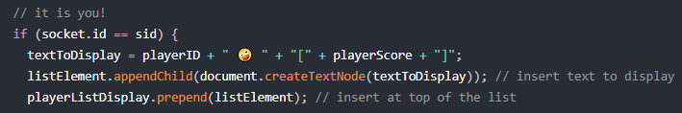
Function drawPlayerList
Notes:
If it is you
We want textToDisplay to contain a text string with your id, an emoji and your score

Slide 42
Function drawPlayerList
Notes:
Create a list element using the text
Put to the TOP of the list

Slide 43
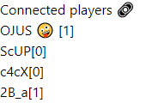
Function drawPlayerList
Notes:
Create a list element using the text
Put to the element to the bottom of the list
With this, we completed this function

Slide 44
Function drawPlayerList
Notes:
Now we look at what if the player is not you

Slide 45
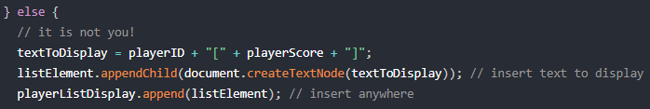
Function drawPlayerList
Notes:
We want to create a text string with the player’s id and the player’s score

Slide 46
Function drawPlayerList
Notes:
Create a list element using the text
Put to the element to the bottom of the list
With this, we completed this function

Slide 47
Function drawPlayerList
Notes:
Create a list element using the text
Put to the element to the bottom of the list
With this, we completed this function

Slide 48
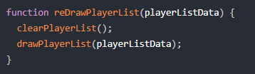
Function reDrawPlayerList
Notes:
Moving onto reDrawPlayerList function
It calls 2 helper functions we mentioned before
Clear the list
Draw the list

Slide 49
Function drawPlayerList
Notes:
Create a list element using the text
Put to the element to the bottom of the list
With this, we completed this function

Slide 50
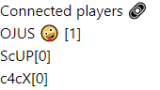
Function drawPlayerList
Notes:
Create a list element using the text
Put to the element to the bottom of the list
With this, we completed this function

Slide 51
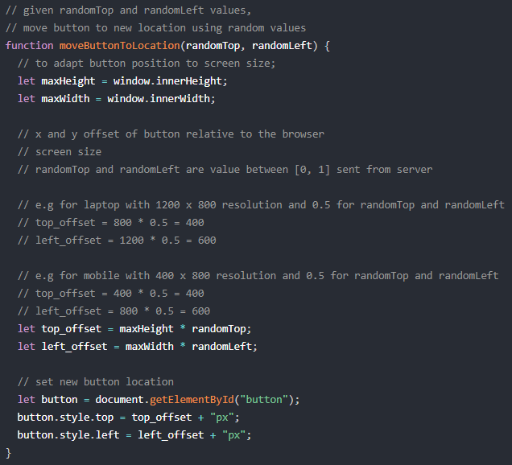
Function moveButtonToLocation
Notes:
Next up is the moveButtonToLocation function

Slide 52
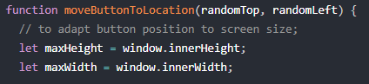
Function moveButtonToLocation
Notes:
This function take in 2 variable which we will be using later.
First, we get the height and width of the player’s screen
Different players have different screen size
We need to adapt our button position base on their screen sizes
So the button we appear in the same position on all the screens

Slide 53
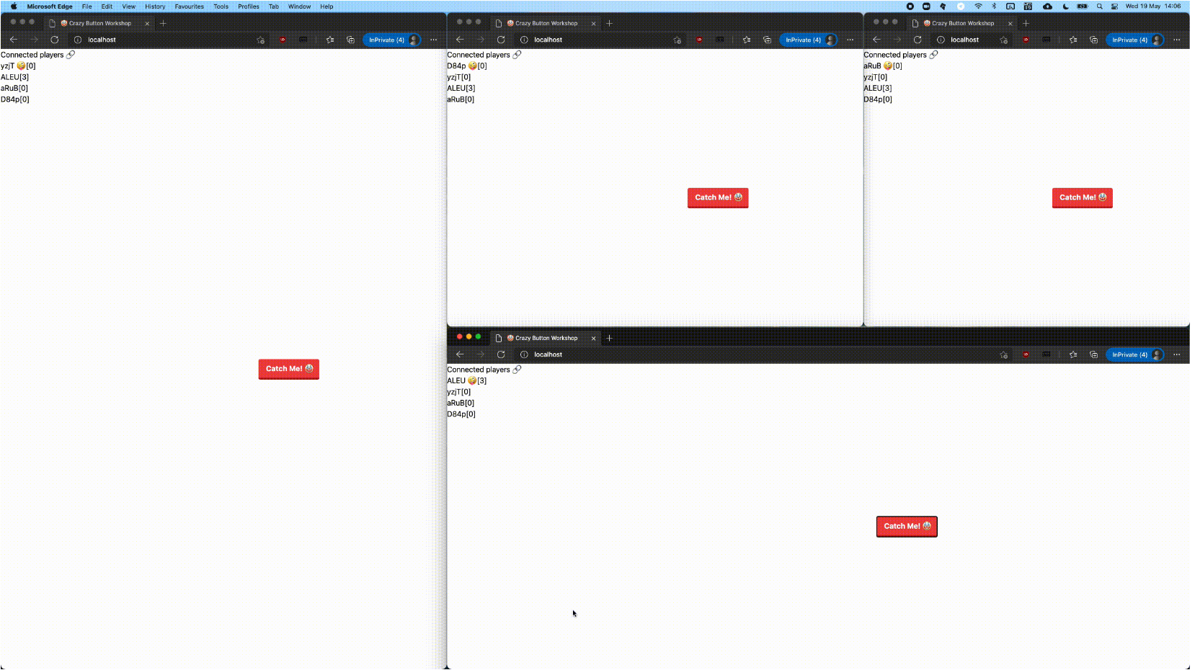
Notes:
Here’s a picture to help you better visualise what we are doing.
We can see there are different screen sizes

Slide 54
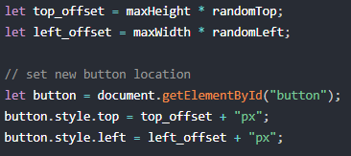
Function moveButtonToLocation
Notes:
Now we calculate the offset of the button from the top and left hand side of the screen
Done by multiplying the height and and width of the screen with the random variables that was passed into the function
Why?
Can anyone guess
randomTop and left is a value between 0 and 1
So its a decimal value and is like a percentage
Eg. 0.2 = 20%
0.1453 = 14.53%
0.0001 = 0.01%
Using percentage, we can get the relative position of the button across all screen sizes
Then we set the new position of the button based on the calculated offsets

Slide 55
top_offset
left_offset
Notes:
Here’s a picture to help you better visualise what we are doing.
And the position of the button is based on the top and left offset of the respective screens

Slide 56
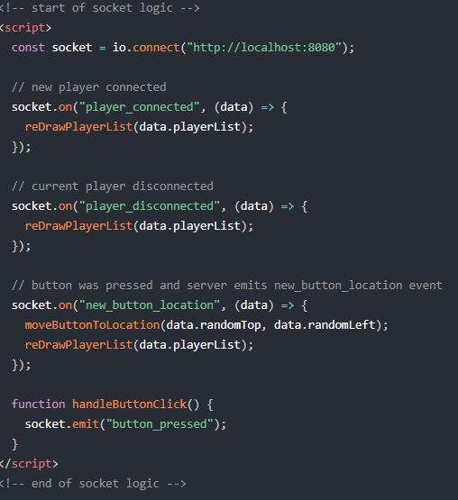
Socket logic
Notes:
Now we move on the socket logic
These codes contain logic of the socket
Meaning, what to do when the client receive or send out data
The socket will call respective helper functions when it detects certain actions
We will examine the codes part by part

Slide 57
Socket logic
socket.on(...)
receiving
socket.emit(...)
sending
Notes:
2 types on socket
On and emit
On = receiving
Emit = sending

Slide 58
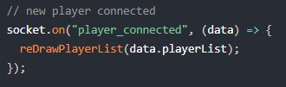
New player
Notes:
When client side socket receives that a new player have joined the game, along with the new data,
It will redraw the leaderboard to include the new player by calling the reDrawPlayerList() helper function and passing the playerlist data into the function

Slide 59
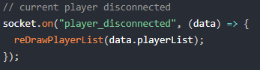
Player disconnects
Notes:
When client side socket receives that a player disconnects
It will redraw the leaderboard also

Slide 60
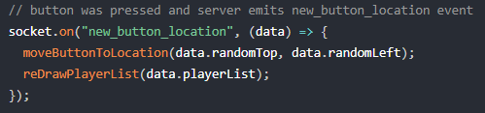
New button location
Notes:
When client side socket receives that the button have been pressed
It will move button to new location and redraw the leaderboard

Slide 61
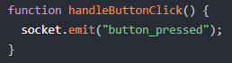
Button pressed
Notes:
When button has been pressed
Client will send out “button_pressed” through the socket
This is the end of socket logic, we can move one to the body of the html file

Slide 62
Frontend

Slide 63
3.2
Backend codes
Notes:
Now let move on the to backend codes

Slide 64
What we want on Backend
Server to emit player_connected event when new player joins in
Sends a list of connected players
Server to emit player_disconnected event when player disconnects
Sends a list of connected players

Slide 65
What we want on Backend
Server to emit new_button_location event when a player clicks the button
Take note who clicked it and update the score
Calculate random values for button to move
Send the random values and list of connected players

Slide 66
What we want on Backend
Current connected playerList should have
playerID
playerScore

Slide 67
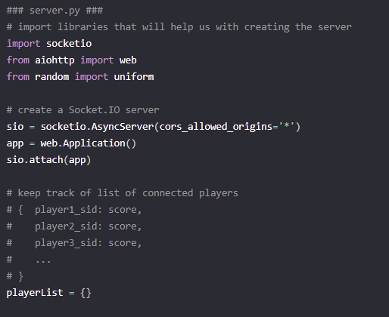
server.py
Notes:
Importing libraries that we need
Creating the socket
Creating a list that will be use to store playerID and their score
//change player_id to player_sid

Slide 68
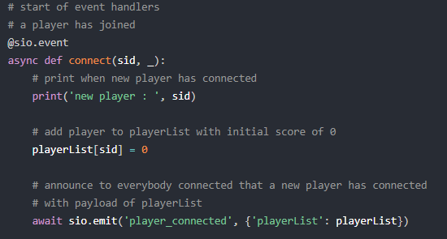
New player joined event
Notes:
Specify that the function we are going to write below is a socket event

Slide 69
New player joined event
Notes:
This function takes in sid of the new player
Sid is a unique string of characters to represents a player
Print out sid of new player in the server
Add the player to the list with score of 0
Server send out “player_connected” and the playerList data

Slide 70
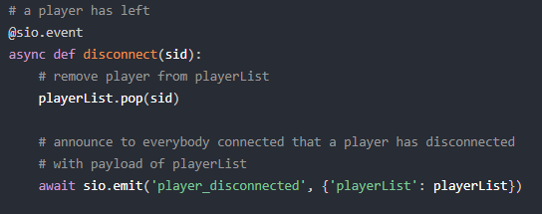
Player disconnected event
Notes:
Specify that what we are going to write below is a socket event
Takes in sid of the disconnected player
Remove the player from the playerList
Server sends out “player_disconnected” along with the updated playerList

Slide 71
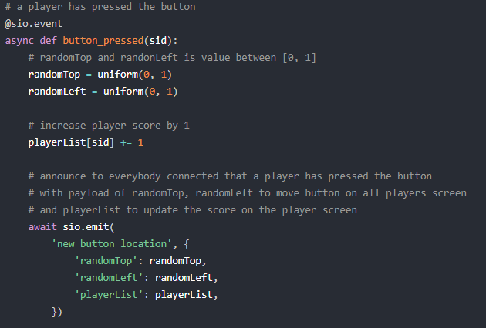
Button pressed event
Notes:
Specify below function is an event
Take in sid of player who clicked the button
Create random values to move the button
Increment the score of the player who clicked the button
Server send out “new_button_location” and the 2 random values along with the updated playerList
End of last event

Slide 72
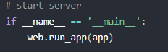
Start server
Notes:
This code just starts the server

